Slide 1
Determining which side
Geometrical properties: similarity and Pythagoras' theorem

Slide 2
how to use Oak lessons

Slide 3
I can identify which side length is missing and use the appropriate form of Pythagoras' theorem to calculate it.

Slide 4
A right-angled triangle has exactly one 90° interior angle.
A hypotenuse is the side of the right-angle triangle which is opposite the right-angle.
Pythagoras’ theorem shows that the sum of the squares of the two shorter sides of a right-angled triangle is equal to the square of its longest side (the hypotenuse).

Slide 5

Determining which side
Identifying the hypotenuse
Right-angled triangles and congruence
Finding lengths of missing sides

Slide 6
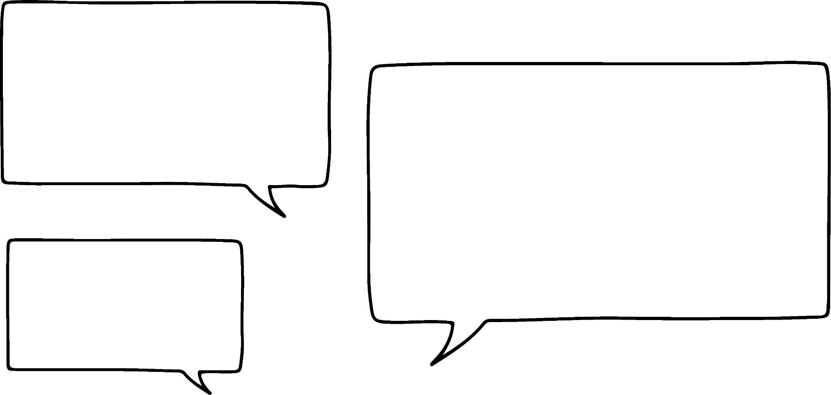

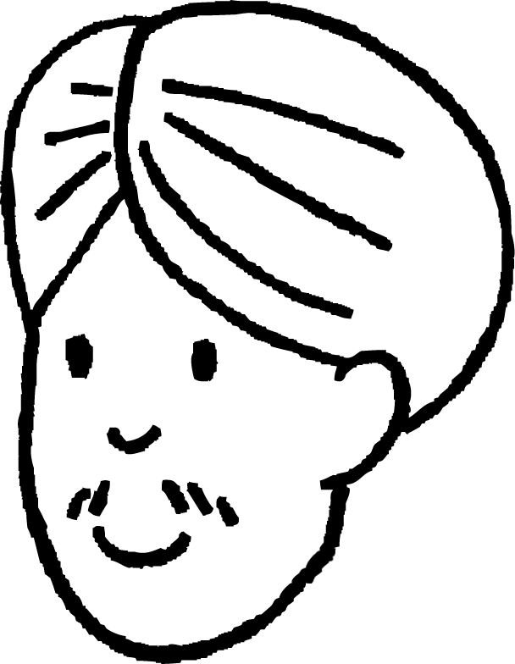
Identifying the hypotenuse
I can use Pythagoras’ theorem on this triangle because it’s a right-angled triangle.
28°
15 cm
Sam
I cannot use Pythagoras’ theorem on this triangle because it doesn’t have a right-angle marker labelled on it.
62°
8 cm
Whose statement about this triangle is correct?
Andeep

Slide 7
Identifying the hypotenuse
Sam is correct.
Pythagoras’ theorem can be used to find the length of a missing side of any right-angled triangle, regardless of whether a right-angle marker is shown or not.
28°
15 cm
If a right-angle marker isn’t clearly shown, then it is helpful to:
62°
find the right angle
identify which side of the triangle is the hypotenuse
8 cm

Slide 8
Identifying the hypotenuse
28°
Because we know that angles in a triangle sum to 180°, then we know that the size of this angle is:
hypotenuse
15 cm
180°
– 28°
– 62°
= 90°
62°
And since this is the right-angle, the hypotenuse is the side opposite it.
8 cm

Slide 9

Identifying the hypotenuse
We can now use Pythagoras’ theorem to calculate the length of the missing side - this time the hypotenuse.
28°
hypotenuse
hypotenuse² = 15² + 8²
15 cm
17 cm
hypotenuse² = 289
hypotenuse = 289 = 17
62°
8 cm

Slide 10


Identifying the hypotenuse
Which of these four triangles are right-angled triangles?
13 cm
34 cm
78°
b
48°
47°
d
9°
56 cm
42°
72 cm
11°
68 cm
a
c
54 cm
81°
36 cm
48°
12 cm

Slide 11
Identifying the hypotenuse
Which of the sides in each of these right-angled triangles is the hypotenuse?
The hypotenuse is always the side opposite to the right angle.
This means it is the one and only side of the triangle that isn’t a leg of the 90° angle.
9°
d
42°
72 cm
c
a
54 cm
81°
e
36 cm
48°
12 cm
f
b

Slide 12

Identifying the hypotenuse
Why aren’t we allowed to use Pythagoras’ theorem for this triangle?
46°
This angle is only 1° off of being a right-angle!
50 cm
34 cm
43°
180° – 46° – 43° = 91°
Sam
36 cm
And it’s the square of the hypotenuse that’s equal to the square of the other two sides added together.
I think it’s because a hypotenuse can only exist on a right-angled triangle.
Laura

Slide 13
Identifying the hypotenuse
Oh yeah! The area of the largest square is only equal to the sum of the smaller two squares when that angle is a right angle.
The sum of the areas of the two smaller squares are:
area 1156 cm²
area
2500 cm²
34² + 36²
1156 + 1296 = 2452
46°
50 cm
Since this isn’t equal to 2500, this isn’t a right-angled triangle, and so Pythagoras’ theorem doesn’t work.
34 cm
Sam
43°
36 cm
34² + 36² ≠ 50²
As this triangle isn’t right-angled, it has no hypotenuse.
area 1296 cm²
42°
53.5 cm
39 cm
47°
36 cm

Slide 14
Identifying the hypotenuse
In which of these triangles is Pythagoras’ theorem true?
hypotenuse
area
37 cm²
area
40 cm²
c
a
b
area
77 cm²
area
19 cm²
area
10 cm²
e
62°
area
8 cm²
f
45°
d
38°
10 cm

Slide 15
Identifying the hypotenuse
1) Complete each statement.
a) Pythagoras’ theorem can only be used to calculate the length of a missing side of a triangle if one of its sides is a ____________.
b) Only ________________ triangles have a hypotenuse.
c) The hypotenuse is always opposite the ________________.
2) Write a sentence to explain why Pythagoras’ theorem cannot be used to find the value k.
44°
k cm
39 cm
47°
37 cm

Slide 16
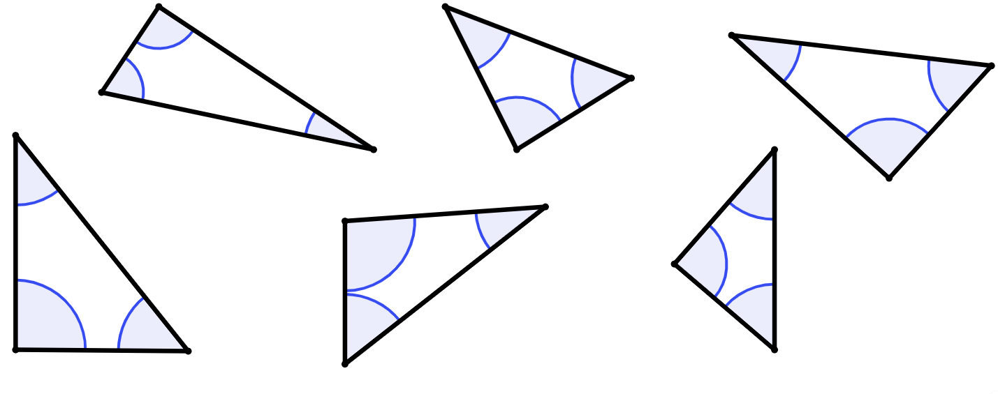
Identifying the hypotenuse
3) For each of these triangles, tick (✔) each right-angled triangle, cross (✘) non-right-angled triangle, put a question mark (?) by each one where you cannot tell.
For each right-angled triangle, circle or highlight its hypotenuse.
a)
b)
c)
68°
52°
d)
22°
92°
41°
39°
e)
34°
f)
52°
50°
51°

Slide 17
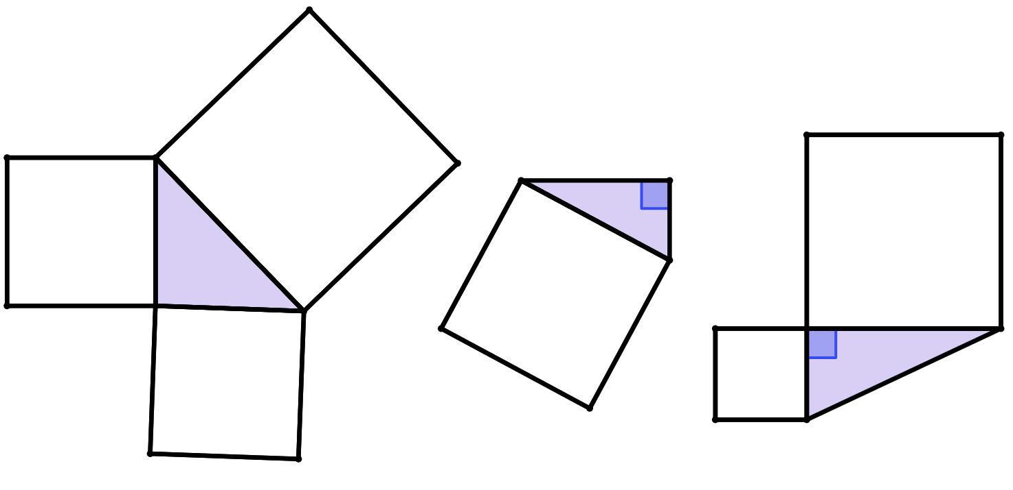
Identifying the hypotenuse
4) For which of these triangles can you use Pythagoras’ theorem?
Where possible, calculate the length of the hypotenuse and label its length.
area
350 cm²
b)
c)
a)
area
169 cm²
area
1201 cm²
area
7569 cm²
area
171 cm²
area
648 cm²

Slide 18
Identifying the hypotenuse
1) Complete each statement.
a) Pythagoras’ theorem can only be used to calculate the length of a missing side of a triangle if one of its sides is a ____________.
b) Only ________________ triangles have a hypotenuse.
c) The hypotenuse is always opposite the ________________.
hypotenuse
right-angled
right angle

Slide 19
Identifying the hypotenuse
2) Write a sentence to explain why Pythagoras’ theorem cannot be used to find the value k.
44°
k cm
39 cm
The missing angle is 89°, and therefore this triangle is not right-angled.
You cannot use Pythagoras’ theorem on triangles that are not right-angled.
47°
37 cm

Slide 20

Identifying the hypotenuse
3) For each of these triangles, tick (✔) each right-angled triangle, cross (✘) non-right-angled triangle, put a question mark (?) by each one where you cannot tell.
For each right-angled triangle, circle or highlight its hypotenuse.
a)
b)
c)
68°
?
52°
d)
22°
92°
41°
39°
e)
34°
f)
52°
50°
51°

Slide 21
Identifying the hypotenuse
4) For which of these triangles can you use Pythagoras’ theorem?
Where possible, calculate the length of the hypotenuse and label its length.
area
350 cm²
b)
c)
a)
area
169 cm²
area
1201 cm²
hypotenuse
87 cm
area
171 cm²
area
648 cm²
area
7569 cm²
hypotenuse
43 cm

Slide 22
Determining which side
Identifying the hypotenuse
Right-angled triangles and congruence
Finding lengths of missing sides

Slide 23
Finding the length of missing sides
These triangles are congruent, because they both have sides of 10 cm and 14 cm.
Okay, I see.
But why does that mean they’re definitely not congruent?
10 cm
triangle A
Is Andeep correct?
14 cm
Andeep
Oh no, I think they’re definitely incongruent.
Since 14 cm is the hypotenuse on triangle B, but not triangle A.
14 cm
10 cm
triangle B
Laura

Slide 24
Finding the length of missing sides
The hypotenuse is the longest side of a right-angled triangle.
Therefore this hypotenuse must be greater than 14 cm.
Therefore this shorter side must be less than 14 cm.
y < 14
x > 14
x cm
14 cm
10 cm
10 cm
triangle A
triangle B
14 cm
y cm

Slide 25
Finding the length of missing sides
Side x and side y cannot have the same length.
These two right-angled triangles are not congruent, as they do not satisfy the SSS rule for congruence.
side lengths of
10 cm, 14 cm, x cm
side lengths of
10 cm, 14 cm, y cm
x cm
14 cm
10 cm
10 cm
triangle A
triangle B
14 cm
y cm

Slide 26

Finding the length of missing sides
I can see why these triangles are different for the same reason.
Oh, I know! It’s because each equation you construct from Pythagoras’ theorem will be slightly different, and so solving each one will give you two different lengths!
24 cm
9 cm
The top triangle, the hypotenuse is 24 cm.
But we don’t know the hypotenuse of the other!
Andeep
I see why!
Because the 24 cm is opposite the right angle on the top triangle.
But on the bottom triangle, the 24 cm is a leg of the right angle. This means the hypotenuse of this triangle is longer than 24 cm.
But why does this matter?
We can use Pythagoras’ theorem on both triangles anyway, since they’re both right-angled?
9 cm
24 cm
Lucas

Slide 27
Finding the length of missing sides
x² + 9² = 24²
24 cm
x² = 24² – 9²
9 cm
x² = 495
x² = 495 = 22.25
22.25 cm
The length of this shorter side is 22.25 cm (2 d.p.)
24² + 9² = y²
657 = y²
25.63 cm
9 cm
y = 657 = 25.63
The length of this hypotenuse is 25.63 cm (2 d.p.)
24 cm

Slide 28
Finding the length of missing sides
Which side (a, b or c) is the hypotenuse of this triangle?
a
31 cm
c
b
30 cm
Which of these equations is correct for this triangle?
44°
46°
31² + 30² = r²
r cm
d
c
e
r² + 31² = 30²
Hence, calculate the length of the hypotenuse of this triangle, rounded to 1 decimal place.
f
r² = 31² + 30²
r² = 1861
g
31² = 30² + r²
r = 43.1 cm (1 d.p.)

Slide 29
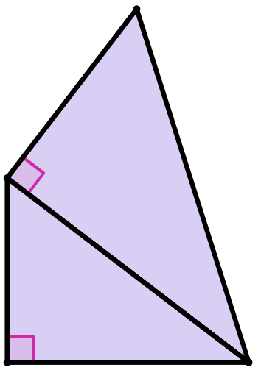
Finding the length of missing sides
Pythagoras’ theorem can be used multiple times on composite shapes made from right-angled triangles.
We use Pythagoras’ theorem in order to calculate a side that is shared by multiple right-angled triangles.
15 cm
B
26 cm
That’s a lot to look at!
Which triangle should I focus on first to find the length of w?
Or does it not matter?
13 cm
A
w cm
Lucas

Slide 30
Finding the length of missing sides
If we try to start with triangle A, we only have one known side length (13 cm).
This means we cannot use Pythagoras’ theorem to calculate the length of the unknown side labelled w cm.
15 cm
B
26 cm
However, we know two side lengths of triangle B (hypotenuse of 26 cm and shorter side of 15 cm).
13 cm
A
Therefore we can use Pythagoras’ theorem to calculate the length of the third side.
w cm

Slide 31
Finding the length of missing sides
The Pythagoras’ theorem equation for triangle B is:
x² + 15² = 26²
15 cm
x² + 15² = 26² – 15²
x² + 15² = 451
B
26 cm
x² + 15² = 451 = 21.23676
The length of the other shorter side of triangle B is 21.23676 cm.
It is sensible to give this length to many decimal places to avoid rounding errors when we use this length again later.
21.23676 cm
13 cm
x cm
A
w cm

Slide 32
Finding the length of missing sides
The side of length 21.23676 cm is a shared side that is:
a shorter side of triangle B
the hypotenuse of triangle A
15 cm
B
26 cm
Now that we know the length of a second side of triangle A, we can now use Pythagoras’ theorem to calculate the length of the unknown side labelled w cm.
21.23676 cm
13 cm
A
w cm

Slide 33
Finding the length of missing sides
The Pythagoras’ theorem equation for triangle A is:
w² + 13² = 21.23676²
15 cm
w² + 13² = 21.23676² – 13²
w² + 13² = 281.9999753
B
26 cm
w² + 15² = 281.9999753 = 16.79
The length of the side labelled w cm is 16.79 cm.
21.23676 cm
13 cm
A
w cm

Slide 34
Finding the length of missing sides
The Pythagoras’ theorem equation for triangle A is:
w² + 13² = 21.23676²
15 cm
w² + 13² = 21.23676² – 13²
w² + 13² = 281.9999753
B
26 cm
w² + 15² = 281.9999753 = 16.79
Wow, that’s cool but it looks really messy with those long decimals!
Is there a way to avoid them?
21.23676 cm
13 cm
A
16.79 cm
Lucas

Slide 35
Finding the length of missing sides
The Pythagoras’ theorem equation for triangle A is:
w² + 13² = ( 451 )²
Rather than converting 451 into a decimal, we can keep it in surd form.
w² + 13² = 21.23676²
15 cm
B
26 cm
How does this help?
What happens if I typed ( 451 )² into my calculator?
21.23676 cm
13 cm
A
Oh, I get 451. That’s less messy!
16.79 cm
Lucas

Slide 36
Finding the length of missing sides
The Pythagoras’ theorem equation for triangle A is:
w² + 13² = ( 451 )²
As squaring and square rooting are inverse operations, ( 451 )² = 451.
15 cm
w² + 13² = 451
w² + 13² = 451 – 13²
B
26 cm
w² + 13² = 282
w² + 13² = 282 = 16.79
21.23676 cm
13 cm
This answer matches the 16.79 cm we calculated using the decimal method.
A
16.79 cm

Slide 37
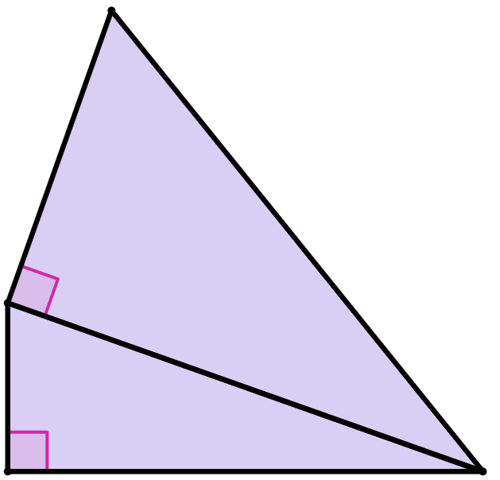
Finding the length of missing sides
Which of these are correct lengths of the shared side labelled k cm?
39² + 20²
a
39² – 20²
b
20 cm
1921
c
39 cm
1121
d
33.48133809
e
k cm
33.4
f

Slide 38
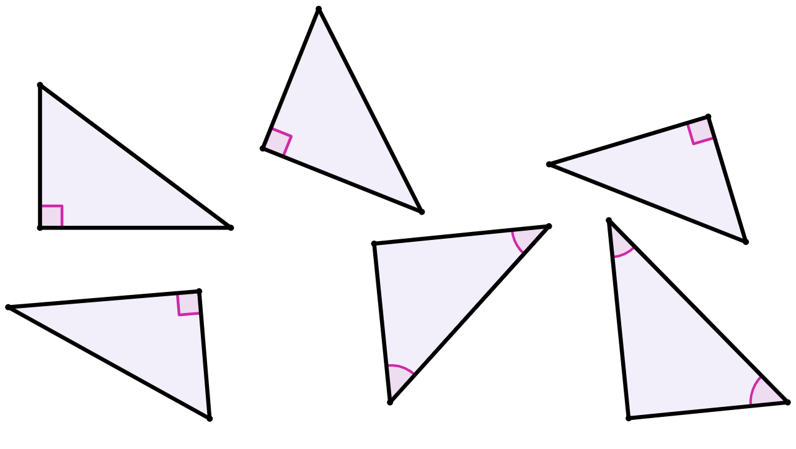
Finding the length of missing sides
1) Match the triangle to the length of its missing side.
g
21.26 cm
16 cm
13 cm
h
25.46 cm
18 cm
a)
20 cm
c)
b)
14 cm
30 cm
i
24 cm
j
49.64 cm
39°
22 cm
42°
15.20 cm
k
58 cm
31.5 cm
l
32.56 cm
e)
24 cm
f)
d)
51°
40.5 cm
30 cm
48°

Slide 39
Finding the length of missing sides
2) Which of these triangles are congruent to triangle X?
63 cm
63 cm
63 cm
a)
c)
b)
16 cm
65 cm
16 cm
16 cm
16 cm
triangle X
f)
63 cm
e)
65 cm
g)
d)
16 cm
67 cm
63 cm
65 cm
16 cm
65 cm

Slide 40
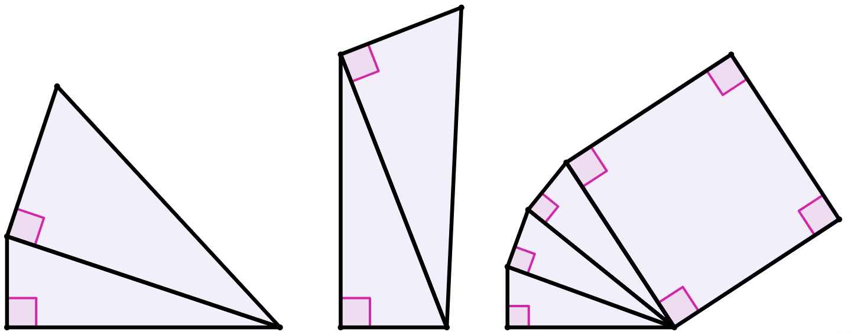
Finding the length of missing sides
3) Calculate the length of each unknown side labelled with a letter, rounding your answer to 2 decimal places.
18 cm
50 cm
56 cm
18 cm
1 cm
a cm
area of square
28 cm²
1 cm
10 cm
1 cm
25 cm
b cm
c cm

Slide 41
Finding the length of missing sides
1) Match the triangle to the length of its missing side.
g
21.26 cm
16 cm
i
13 cm
h
25.46 cm
18 cm
a)
20 cm
c)
b)
14 cm
30 cm
g
i
24 cm
j
49.64 cm
k
39°
22 cm
42°
15.20 cm
k
58 cm
31.5 cm
l
32.56 cm
e)
j
24 cm
f)
d)
h
l
51°
40.5 cm
30 cm
48°

Slide 42
Finding the length of missing sides
2) Which of these triangles are congruent to triangle X?
63 cm
63 cm
63 cm
a)
c)
b)
16 cm
65 cm
16 cm
16 cm
16 cm
triangle X
f)
63 cm
e)
65 cm
g)
d)
16 cm
67 cm
63 cm
65 cm
16 cm
65 cm

Slide 43
Finding the length of missing sides
3) Calculate the length of each unknown side labelled with a letter, rounding your answer to 2 decimal places.
18 cm
50 cm
56 cm
18 cm
1 cm
a cm
area of square
28 cm²
1 cm
10 cm
1 cm
25 cm
b cm
c cm
a cm = 32.39 cm
b cm = 17.66 cm
c cm = 5 cm

Slide 44
Determining which side
The hypotenuse of a right-angled triangle can be identified as:
the side opposite the right angle marker
the side adjacent to two angles that sum to 90°
Since addition is commutative, the sum of squares of the two shorter sides can be written in either order, meaning there are multiple representations of the Pythagoras’ theorem equation for any given triangle.
Pythagoras’ theorem can be applied repeatedly to composite shapes made from right-angled triangles.

Slide 45

© Oak National Academy 2024.
Produced in partnership with Mathematics in Education and Industry.
Licensed on the Open Government Licence v3.0, except where otherwise stated. See Oak terms and conditions.

